Slide 1









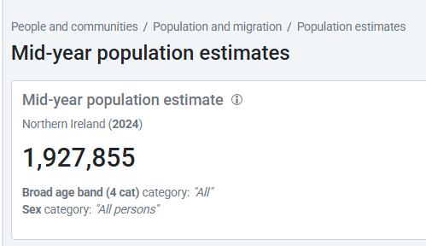
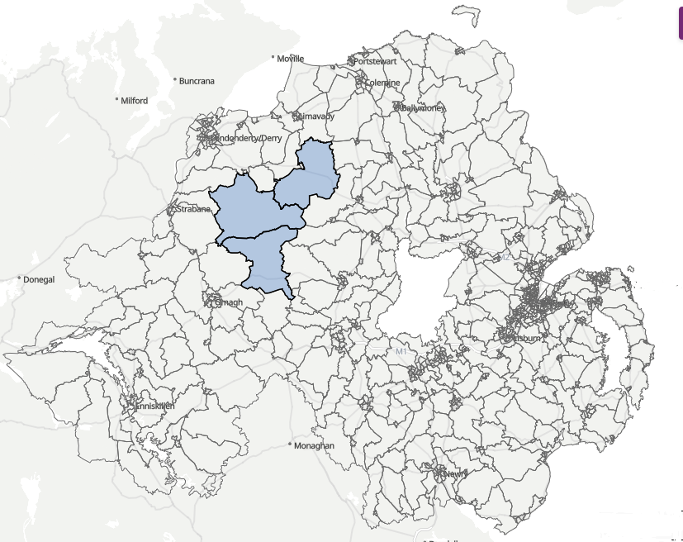
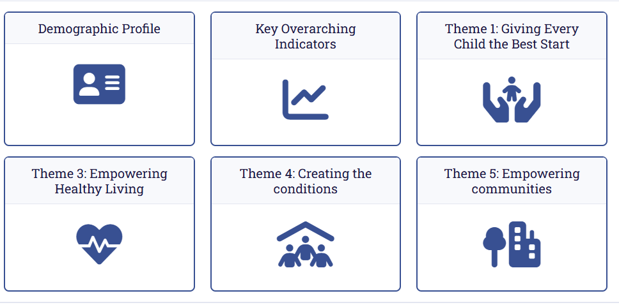
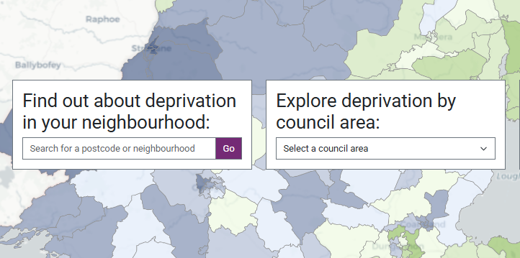
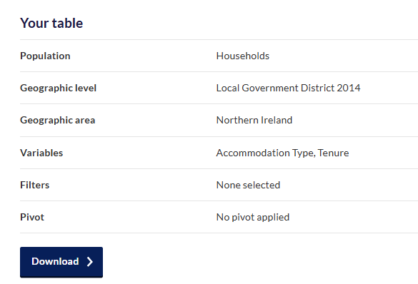
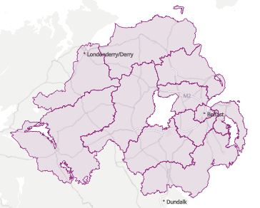
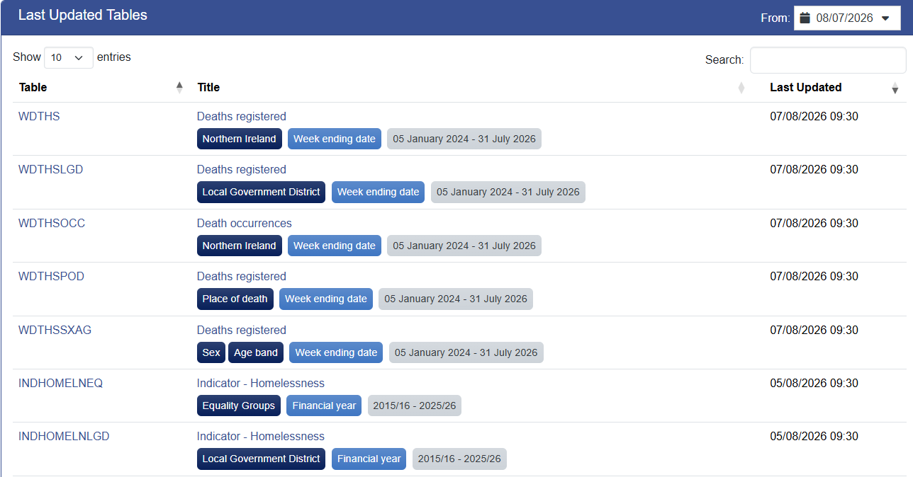



NISRA explorer
Find and extract the data you need using our tools and visual resources
Geographic data tools and maps
Policy specific
Equality and deprivation
Database or lookup tools
Mobile
friendly
Accessible
Dive into the data using tools
Search by keyword
Find data on population, housing, health, education and more for your area
View progress towards key indicators of wellbeing as a society
Assess differences between equality groups for key statistics across NISRA
Download and view maps, charts and tables of NISRA data
Northern Ireland local statistics explorer
Government wellbeing framework
Equality matters
Data explorer
Go
Go
Go
Go
Define a custom geography and view statistics for your selected area
View indicators relating to themes under making life better strategy for Health Trusts
Find out about deprivation in any local neighbourhood or council
Download and view maps, charts and tables of NISRA data
Custom area profile builder
Public Health Agency
Making life better
Deprivation in Northern Ireland
Census flexible table builder
Go
Go
Go
Go
Census data for councils, district electoral areas, and smaller statistical areas
View indicators relating to social, economic and environmental change
Access data by theme, year and geography. Download CSV, excel, JSON or API.
Census area explorer
Social, economic and environment indicators
Data portal
Go
Go
Go
People and communities
Overview of purpose
Overview of purpose
Overview of purpose
Dashboard name
Dashboard name
Dashboard name
Go
Go
Go
Health and social care

